Slide 1
May 20, 2014

Slide 2
Quote of the month:
We must serve more youth.
We must keep our programs relevant to the youth of today and tomorrow
We must deliver what we promise.
Our measure of success must be viewed through a single question, “does it make a difference in the life of a child.”
CSE Wayne Brock
Notes:
Q: Who did you prefer portraying, Han or Indiana?
A:I think Indiana Jones was a lot of fun to do because of the places we went to and the adventures and the action. But Han Solo was also a huge part of my life.
Q: What movie quote do you get asked to do the most?
A: "Get off my plane.“
Q: If you and Mark Hamill fought who would win?
A: Me, of course.

Slide 3
Strategy:
Help parents understand that Scouting makes the most of the little time they have to impact their children.

Slide 4
Campaign:
Build Your Adventure
ADVENTUE IS WAITING BUILD YOURS

Slide 5
COMMISSIONER General Updates

Slide 6
#1 Priority
No Change???

Slide 7
Journey to Excellence

Slide 9
Annual Service Plan
June
Outdoor Program Review
Commissioner Conference
July
Unit Health Assessment
Jun/Jul/Aug
Unit Program Planning
http://commissioner-bsa.org/service.html

Slide 10
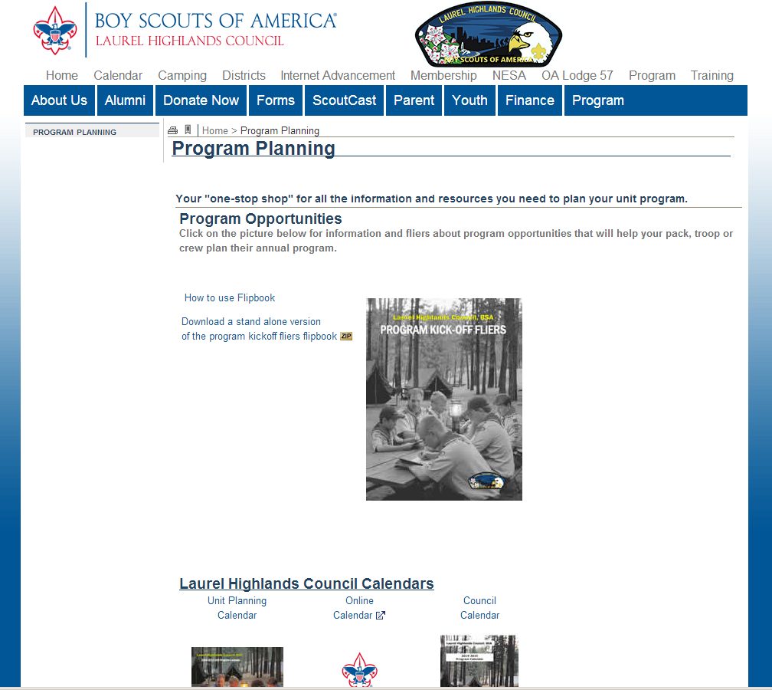
Unit Program Planning
http://lhc-bsa.org/programplan

Slide 11
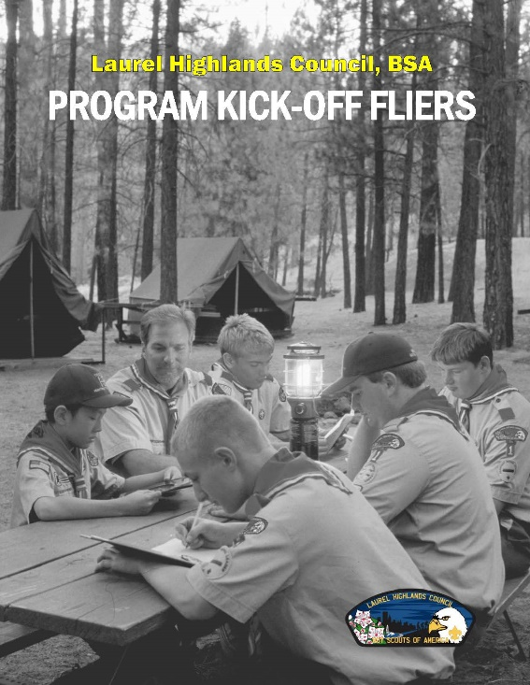
“New” Electronic Fliers

Slide 12
Looking Ahead
Plan to Visit Summer Camp
Relax & Refresh
12

Slide 13
Suggestion

Slide 14
UPDATE
Commissioner Toolbox
Likely to be late…

Slide 15
Career Enhancement
How is MORALE in your District?!
The district commissioner is the chief morale officer of the district!!!
They should be upbeat, personable, determined, and a role model for Scouting ideals.
They should be passionate about the benefits of Scouting and a champion of the unit to make Scouting happen in the lives of young people.
Council Commissioner Manual #522-015

Slide 16
Commissioner Conference
15 Registered
Council | 3
Conestoga | 4
Frontier | 2
Beaver | 1
Forbes Trail | 1
Lackawanna | 1
Potomac | 1
Japeechen | 1
Chestnut Ridge | 1

Slide 17
Commissioner Conference
A commissioner conference should be held on an annual basis and should be the commissioner’s highlight of the year.
The conference should be a highly informative planning, morale-enhancing, and team-building event.

Slide 18
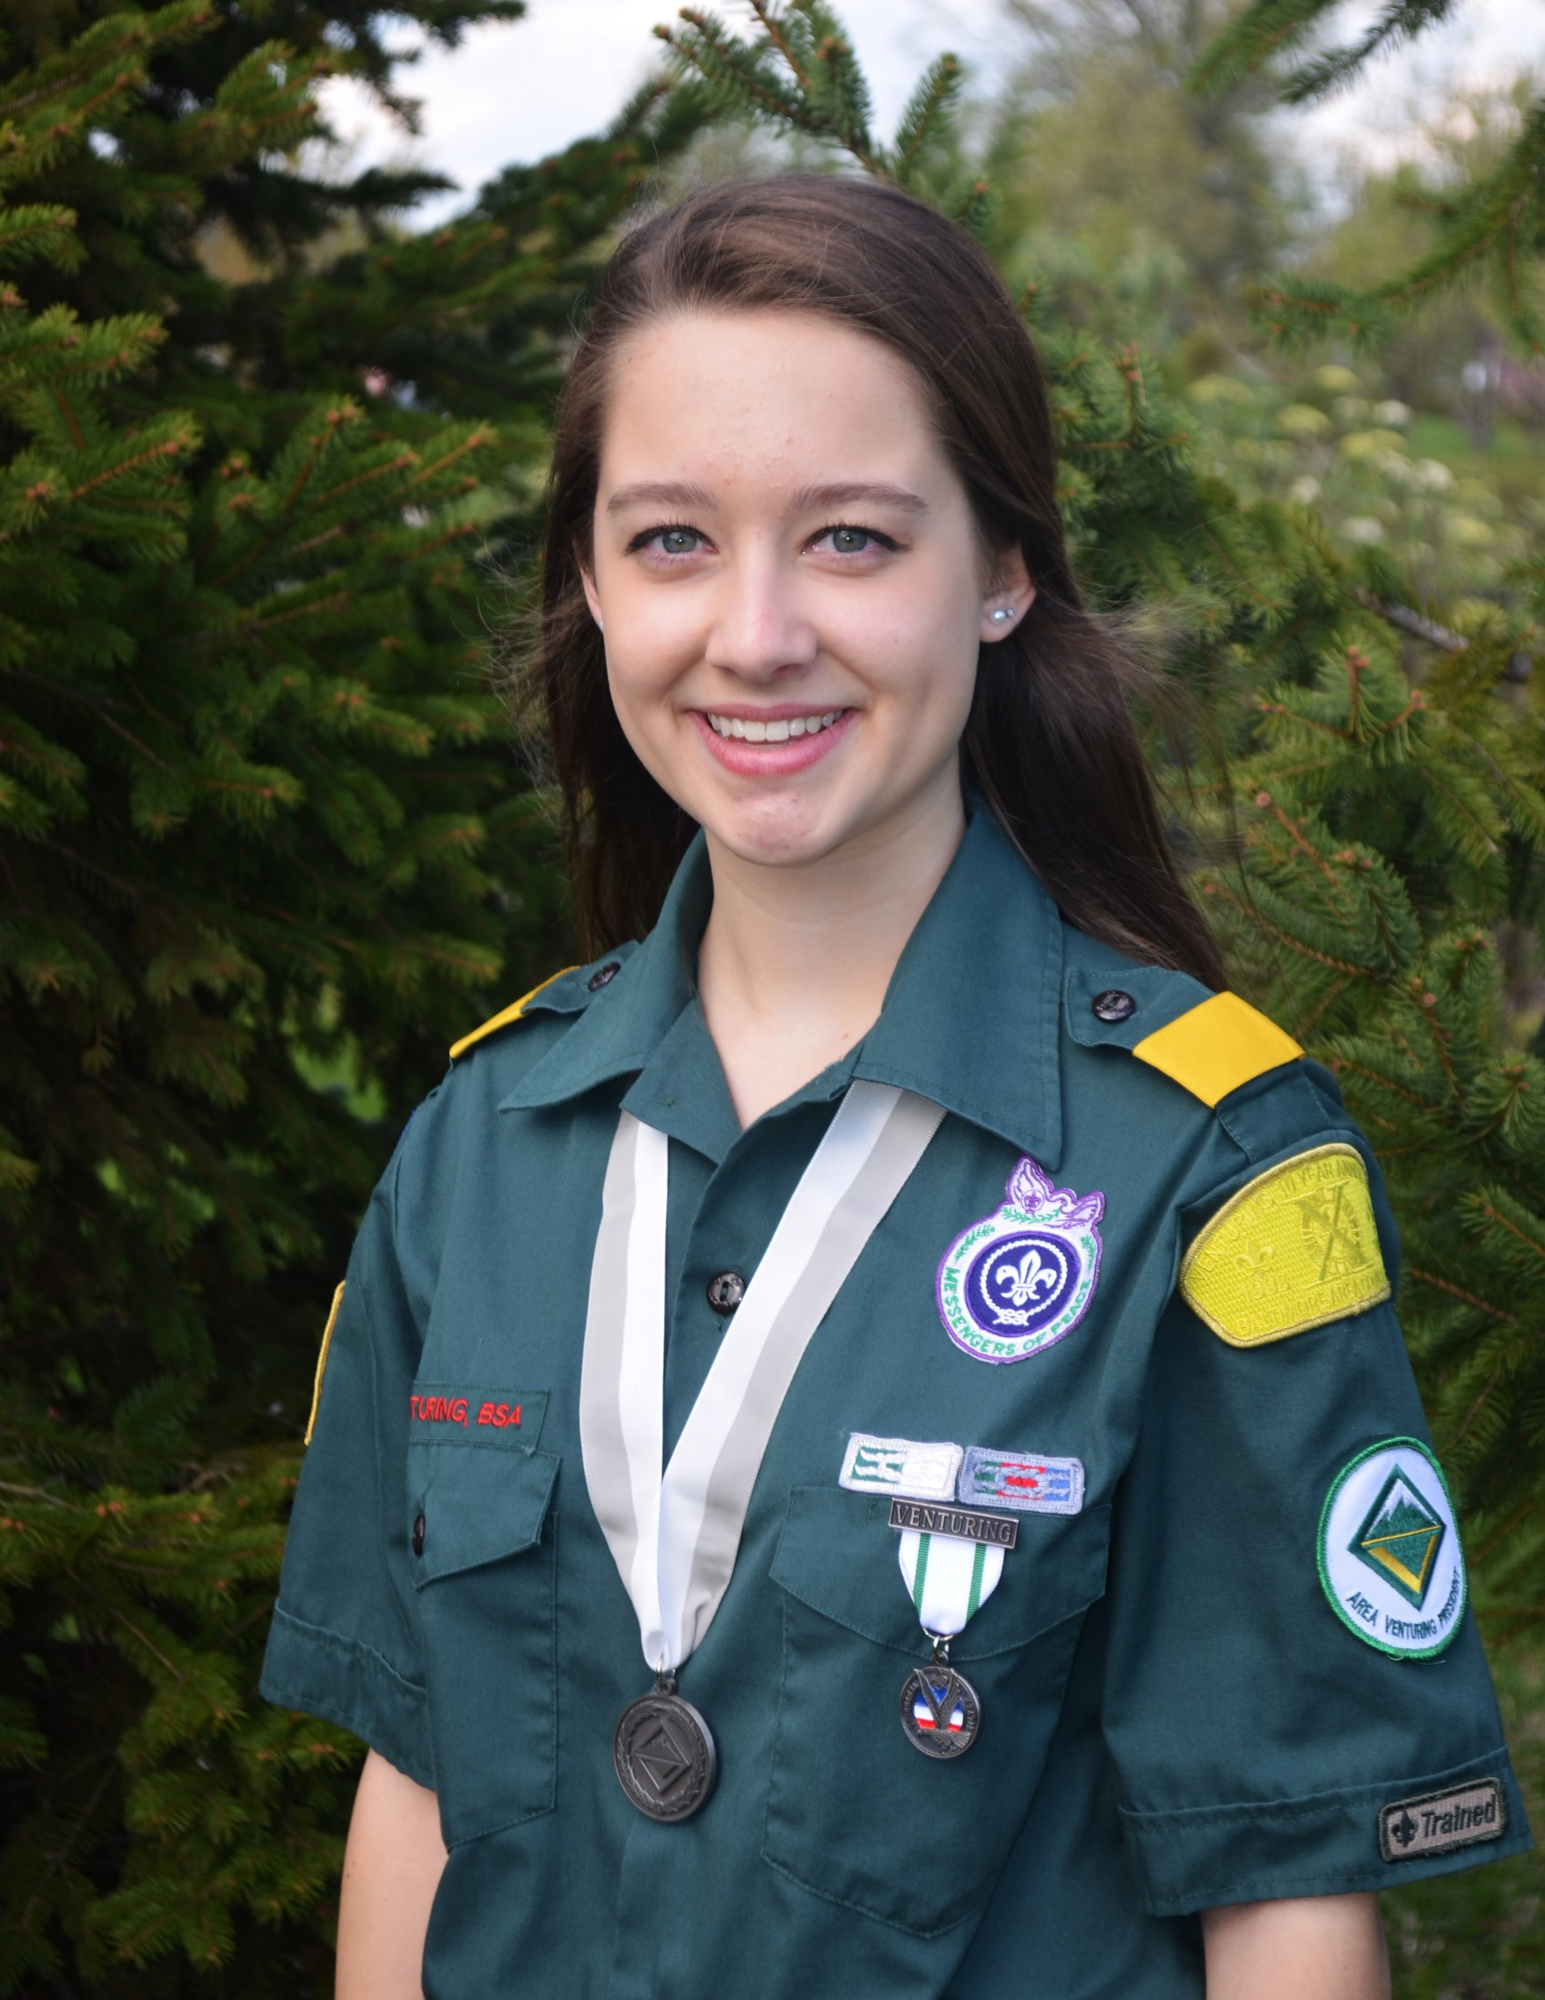
Commissioner Conference
June 7 Camp Seph Mack
Steak & Shrimp Dinner
Team Building & Fun
DCSA Presentation
June Cabinet Meeting
Basic & Advanced Training

Slide 19
SCOUT FAMILY Nite @ Washington Wild Things
Commissioner Nite @ Washington Wild Things
Sunday, August 24
$15 includes Tailgate Party

Slide 20
COMMISSIONER Training Updates
Jack Boyde
Assistant Council Commissioner – Training & Recognition

Slide 21
COMMISSIONER Training Updates
June 7, 2014 – Sponsored by Area 6 8:30 AM (Part of Commissioner Conference)

Slide 22
COMMISSIONER Training Updates
June 7, 2014 – Council Led 8:30 AM (Part of Commissioner Conference)

Slide 23
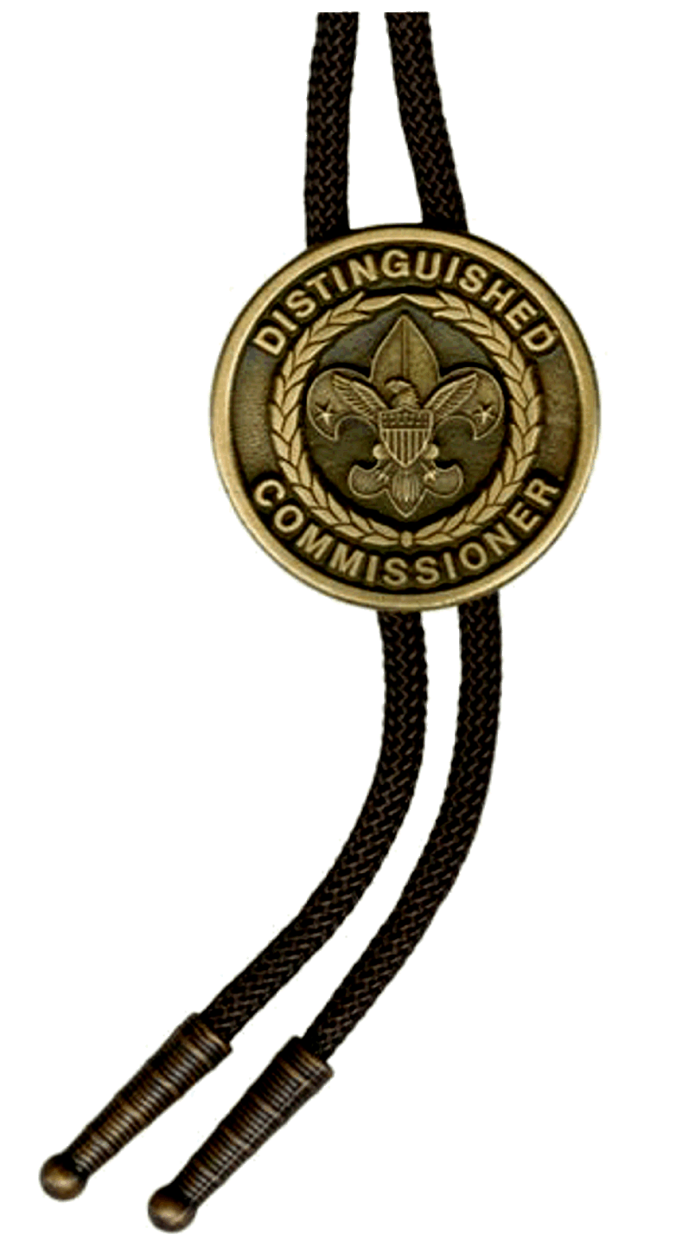
COMMISSIONER Recognition
D.C.S.A.
Distinguished Commissioner Service Award

